Slide 1
Vision 80/20 by 2020
AfPIF 2017, Abidjan
Funke Opeke
Notes:
.

Slide 2

Nigeria: Economic Indicators
Where is Africa on the map?
Africa’s internet capacity growing faster than other world regions.
Grew 41 percent between 2014 and 2015, and 51 percent compounded annually over the last five years, to reach 2.9 Tbps
Nigeria (214Gbps), Ghana (106Gbps) & Cote D’Ivoire (132Gbps) lit capacity
Oceania grew 47% per year between 2011 and 2015 to reach 2.1 Tbps
Latin America and the Middle East grew 44 percent per year to 20.6 Tbps and 8.4 Tbps
Influx of undersea broadband cables, like the SEACOM, EASsy, MainOne, WACS and ACE have helped accelerate Africa’s access to international bandwidth by 20-fold in 5 years
Africa leads in Internet Capacity Growth
Source: ITU, World Bank (2013)

Slide 3
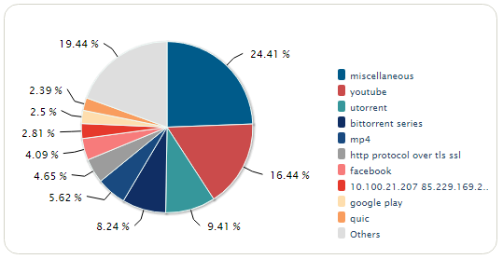
Experience shows 20:80 traffic mix is the order of the day
Sample public wifi data traffic: Lagos 2017

Slide 4
Who is carrying Nigerian Retail Consumer Internet Traffic?
Network | # of Internet Users
MTN | 31,691,070
Glo | 27,184,002
Airtel | 20,174,089
9Mobile | 12,549,596
All Other | 30,309
Total | 91,629,066
Percent of online sites viewed via
mobile networks in Nigeria is 81%
(Statcounter web traffic analysis)

Slide 5
What is happening at the Nigerian Internet Exchange?
IXPN@Saka | Gbps | IXPN@RackCenter | Gbps
Swift | 1.6 | Smile | 1.2
Google1 | 6.6 | Sub-Total | 1.5
Google2 | 6.6
GIX | 1.0 | IXPN@MDXi
Airtel | 5.4 | MainOne | 2.0
Spectranet | 2.5 | Sub- Total
Others
Sub-Total | 28.3 | Total IXPN | 31.5

Slide 6
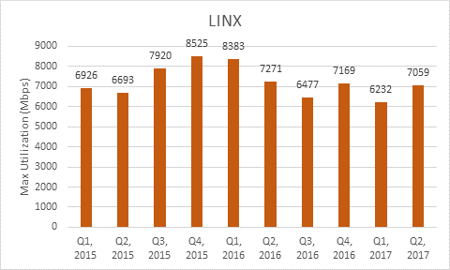
A view of traffic on AS37282: 2015 to now

Slide 7
What National Backbone connectivity is there in Nigeria?

Slide 8
Nigeria: Economic Indicators
How then does the traffic flow?
Proprietary or outbound?
Core routers for Multinational MNOs operating in Nigeria take traffic outside the country and with the exception of Airtel that is exchanging measureable traffic at IXPN
Even indigenous and government agencies do not peer at the Exchange in Nigeria
Majority of local content enjoyed in region is served from offshore
In Ghana, NITA and Government agencies prominent in the Exchange

Slide 9
Nigeria: Economic Indicators
Why is traffic staying offshore?
Pervasive proprietary infrastructure within national boundaries controlled by mobile operators – closed networks
Limited local content or applications with mass appeal and relevance
High cost of local hosting relative to hosting content in data centers in economies with scale
Absence of key inputs – Data Centers, CDNs, Skills, Local businesses online to drive growth
Weak formal intra-African trade flows
Low addressable market demand and immaturity of market which has largely developed along closed lines in past 5 – 10 years
Is it solely anti-competitive behavior?

Slide 10
Nigeria: Economic Indicators
What is the traffic that could be served onshore?
Low volume traffic from banking applications have had the most impact
Early stages of digital transformation:
Globally, user generated content more prevalent with the expansion in social media and sharing economy
Other applications such as entertainment, e-commerce, e-government, Health and education still very immature
Some countries yet to fully migrate banking online
Local business to consumer online engagement yet to reach critical mass
Some localization by OTT players starting to show up
Google Maps, Streetview, Health app etc.
Do we have critical mass in local content?

Slide 11
Nigeria: Economic Indicators
Why does it matter?
Does anyone other than AfPIF really care?
Continued high cost of Internet access.
Continued poor performance
Africa’s youth population needs improved Internet access and digital skills to create jobs and ensure economic stability
Implementation of bad policy regimes that actually stifle Internet growth on the continent
High latency
Huge impact of submarine cable outages
3 repairs in 3 months on West Coast: June – MainOne, June – ACE Shunt fault, July SAT3
Why am I unable to reach my local bank or taxi company because there is an outage in the Atlantic?

Slide 12
Nigeria: Economic Indicators
What needs to be done?
Increase attractiveness of regional Interconnect Access Points
Measured regulatory intervention/incentives
OTTs also need to localize content in Data Centers on the Continent
Increase number and capacity of Exchange Points
Further incentivize by offering public and private peering at local exchanges
Largest carriers i.e. MNOs need to exchange traffic at local exchanges
Sustained economic growth and ease of doing business across the continent
Build scale and cost efficiency into regional Data Centers and backhaul networks

Slide 13

Thank you

