Slide 1

Benin IX: 3 years after!
State of play and perspectives
AfPIF 2017,
Abidjan, 22 to 24 August 2017
Yazid AKANHO

Slide 2
Agenda
Benin : A Quick SUmmary
Benin IX:
  Architecture and services
  Impacts in benin internet ecosystem
  Weaknesses and challenges
  Perspectives

Slide 3
Benin : a Quick SUmmary
+11 Millions Beninese
4 GSM : Libercom, Moov, MTN, Glo. All provide Internet to their subscribers.
2 national operators: BTI (Infrastructure) and Be Telecoms (end users services).
3 4G/LTE networks: MTN, Be Telecoms and Moov
11 ISP authorized by ARCEP (regulator).
≈ 3 Millions Internet subscribers, internet penetration : 27%. (ARCEP statistics Q4 2016).
2 submarine cables : SAT-3 and ACE

Slide 4
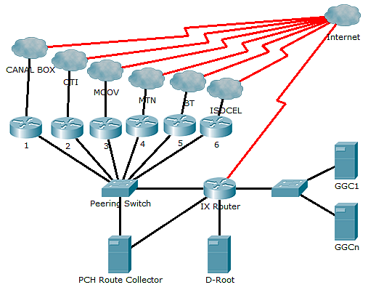
Benin IX: Architecture and services
N° | AS | Peer Name
1 | 37090 | ISOCEL
2 | 28683 | BTI
3 | 37424 | MTN Benin
4 | 37136 | Moov Benin
5 | 37292 | OTI
6 | 36924 | Canalbox Benin
7 | 3856 | PCH
8 | 42 | PCH/AS42
Benin IX
peers
N° | Service
1 | D Root (local)
2 | Google Global Cache (GGC)
3 | Route Collector
4 | Peering
Benin IX
services
Benin IX architecture
Notes:
At peering switch,
Services and peers are in separate VLANs

Slide 5
What does Benin IX bring into Benin internet ecosystem ?
Basic limited test: RTT comparison for www.gouv.bj and www.dei-benin.com from users in network connected to IX and network not connected to IX: 20 to 80% improvement in RTT response for resources hosted locally.
local Google Cache is available.
Most ISPs reduced their internet packages cost to subscribers. But this is not only related to the IX !!!
Better youtube experience: Youtube is clearly recognized by Beninese to be fast since more than one year now (thanks to Google Cache!).

Slide 6
Round Trip Time comparison based on resource and user locations
Notes:
Those graphs are based on scenario 1 and 2 described in the slides before.
We clearly see that when resource is locally hosted in a network connected to the IX, a user also connected to the IX has better user experience (based on RTT).
On the contrary, green line, which shows round trip for user accessing a local resource from a network not connected to the IX, confirm that user experience is the worst.

Slide 7
Benin ix: Weaknesses and Challenges
Internal to IX
Governance:
Design/config:
External to IX
No business model: no operational budget, no fees, expansion is limited !
No visibility in operations and projects
Contents & services:
Local traffic almost inexistent: most of internet traffic is summarized into Google, Facebook, Youtube, Twitter …
Few services hosted locally: infrastructures still rare, expensive and unstable: carrier neutral datacenters, energy; physical connectivity and technologies (fiber, high prices, ;
Confusion between the IX, AXIS and AFIX
Government still involved in the IX management
Limits in statistic available: graph per member, Open Data!
More services : ccTLD, NTP, …
No dedicated staff : administrative & technical (paid Vs volunteers)
Dominant ISPs consuming more services: usage may be seen unfair !
No redundancy in the architecture: Fidjrossè equipment's are dormant
IPv6 not available

Slide 8
Perspectives
Benin-IX Governance Comity: not for-profit association of 10 seats composed of MENC, BTI, GSM operators, ISPs, users/associations for : Benin IX governance and strategy, local connectivity, peering and content/service providers improvement to develop digital economy
“Agence du Numerique”: should play a key role in the high level development of technology in Benin, particularly in infrastructures and policies: build datacenters, assist with other structures in projects like PDI2T, digital TV, code for digital are few actions which should improve the role of Benin IX in the internet ecosystem in Benin.
Digitization of government & private services: government, public/private sectors services being digitalized (visa, passport, enterprise creation, aircraft tickets, taxe fees, bills,…).

Slide 9
Thank you!

